Slide 1
2024 Medicaid Statewide Provider Training
Managed Care
Notes:
This is a template. Please make a copy/duplicate of the template before editing.

Slide 2
Agenda
Overview of Managed Care
Billing
Dental
Q&A
Notes:
I don’t know what the line is at the bottom of the list or how to get rid of it.

Slide 3
Managed care
Managed care is a health care delivery system organized to manage cost, utilization, and quality. Medicaid and CHIP managed care provides for the delivery of health benefits and additional services through contracted arrangements between the Department of Health and Human Services (DHHS) and Managed Care Entities (MCE).
Medicaid managed care programs:
ACO - Accountable Care Organizations (physical health)
UMIC - Utah Medicaid Integrated Care (physical health and behavioral health)
  Only in five counties: Weber, Davis, Salt Lake, Utah, and Washington counties
HOME - Healthy Outcomes, Medical Excellence (physical health and behavioral health)
Dental
PMHP - Prepaid Mental Health Plans (behavioral health)
CHIP managed care programs:
MCO - Managed Care Organizations (physical health and behavioral health)
Dental
For more information and latest managed care information, please visit https://medicaid.utah.gov/managed-care/

Slide 4
Billing a managed care plan
Providers must contract as a network provider or be enrolled as a paneled provider in each managed care plan prior to rendering services to a member enrolled in a managed care plan.
Providers must ensure that any prior authorizations or criteria required by the managed care plan are followed.
Providers should utilize the Eligibility Lookup Tool prior to rendering services to know if a member is enrolled in a managed care plan on the date of service.
  The tool can be found at: https://medicaid.utah.gov/eligibility/
Providers must contact the member’s managed care plan for billing and claims questions.

Slide 5
Managed care entity contact information
Managed Care plan name | Plan type | Phone | Website
Health Choice | ACO/Integration | 1-877-358-8797 | www.healthchoiceutah.com
Healthy U | ACO/Integration/CHIP | 1-833-981-0212 | www.uhealthplan.utah.edu/medicaid
Molina Healthcare of Utah | ACO/Integration/CHIP | 1-888-483-0760 | www.molinahealthcare.com
Select Health Community Care | ACO/Integration/CHIP | 1-800-538-5038 | www.selecthealth.org/plans/medicaid
HOME Program | HOME | 1-800-824-2073 | healthcare.utah.edu/hmhi/programs/home
MCNA Dental | Dental | 1-844-904-6262 | www.MCNAUT.net
Premier Access Dental | Dental/CHIP Dental | 1-877-541-5415 | www.premierlife.com/utmedicaid

Slide 6
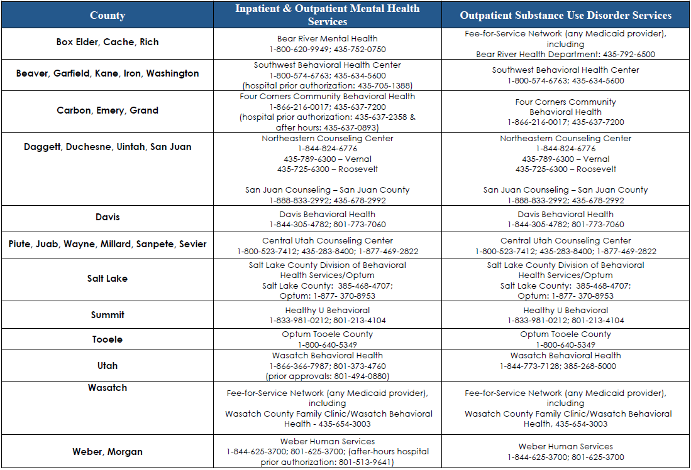
Managed care entity contact information
Prepaid Mental Health Plans

Slide 7
Medicaid
dental services
Notes:
In the next few slides we will provide an overview of the who is eligible for full dental coverage and how that coverage is administered to different populations.

Slide 8
Medicaid dental managed care
Utah Medicaid contracts with two dental plans statewide to provide dental services to eligible Medicaid enrollees.
In the subsequent slides we will discuss:
Services covered by dental managed care plans
Services not covered by dental managed care plans

Slide 9
Utah Medicaid
dental delivery networks
Member’s are assigned to a delivery network based on their Medicaid eligibility.
The three Medicaid dental networks are:
  Fee for Service
  Managed care dental
  University of Utah School of Dentistry (UUSOD)
Utah Medicaid contracts with two dental managed care plans to provide dental services statewide:
  Premier Access
  MCNA Dental
Members assigned to a dental managed care plan must see a dental provider listed in their dental plan network.
Once they choose a dental managed care plan, members have 60-days to make a different selection and after that they must wait until the annual open enrollment if they want to change their plan.
Members assigned to the UUSOD must use dentists who are on their statewide panel of providers.
Notes:
Utah Medicaid provides full comprehensive dental coverage through several different delivery networks and member’s are assigned to a particular network based on the Medicaid program they are eligible for. There are three Medicaid dental networks - FFS, Managed Care and the University of Utah School of dentistry. - There is no open enrollment for member’s who are assigned to the UUSOD for their dental services.

Slide 10
Dental delivery by model and population
State Medicaid
Fee for Service
Dental managed care plan
Fee for Service
University of Utah School of Dentistry (UUSOD) and their statewide panel of providers
Premier Access Dental
MCNA Dental
Children, ages 0-18
Members with a disability, ages 19-20
Pregnant members
Members, ages 19-20, who qualify for EPSDT
Adults on Nursing Home Medicaid
Children in foster care
TAM members in SUD treatment
Blind and disabled adults, ages 21-64
Adults, ages 65 and older
Notes:
This chart shows the different dental delivery models and which populations are assigned to each network. State Medicaid Fee for Service offers two different dental networks, Fee for Service and the University of Utah School of dentistry. Members who receive their coverage through Fee for service are… Members who receive their coverage through the UUSOD are…, The next delivery network is Dental Managed Care. Members who receive their coverage through a dental managed care plan are…

Slide 11
Dental managed care plan services
In addition to paying for dental services, dental managed care plans can help:
Coordinate dental care for members with special healthcare needs.
Arrange for and provide interpretive services.
  Members must use an interpreter contracted with their dental plan.
  Providers can and should refer Medicaid patients to their dental plan to arrange for an interpreter.
Provide case management for members who need to see a specialist.
Help providers and members find dental specialists on their network.
Resolve billing and third party liability (TPL) problems.
  Providers and members should contact their dental plan if they have questions about a bill or an unpaid claim.

Slide 12
Services not covered by the dental managed care plan
There are some services that are not covered by the dental managed care plan but may be covered by the medical plan or FFS. These are called “carve-out” services.
Some carve-out services from the dental managed care plans are:
The facility fees for dental anesthesia in a hospital or ambulatory surgical center.
Transportation services, both emergent and non emergent.
Dental services related to the correction of oral maxillofacial anomalies.

Slide 13

Contact us
For additional questions, please email:
Dental managed care
Jennifer Wiser: jwiser@utah.gov
ACO and HOME plans
Trevor Smith: trevorsmith@utah.gov
UMIC plans
Becky Johnson: beckyljohnson@utah.gov

